Slide 1



Natural Language Processing
CSE - 4022
PROJECT REVIEW - 3
TAMIL NEWS
CLASSIFICATION
Team Members:
SHRIKUMARAN P A | 20BCE1082
R. SHRUTHI | 20BCE1375
DASARI.NAGAVENI | 20BCE1715

Slide 2


Video link
https://drive.google.com/drive/folders/1HCS9AXzAuy6tmnwnAF3BvYDlrIcnCcYZ

Slide 3
Introduction
News is the day to day information we receive about the happenings all over the world. News and media play a major role in today’s society. Some people might like to know the news of happenings all over the world while some like to keep themselves updated on sports news. There is a definite structure and procedure for writing various forms of news and their headlines. So the words used for each category of news is different separated by stopwords and other conjunctions. In English the common stopwords are “the”, “and”, and so on. So categorisation of the news can be done by removing the stopwords and the punctuations in the sentences. Natural Language Processing is used for this purpose of categorisation of the news by parsing the news for main words in the news. This paper discusses the methods that can be used for categorising news in Tamil. The following sections will discuss the related work, future scope, and the methodology used to build the efficient models for Tamil news classification.

Slide 4
Abstract
In the Project we collected the news in Tamil and splitted it into training and testing data. Here, the sentences from each category are grouped and the individual tokens are extracted from it. The test data can be tokenized and matched with the words in each category. The category with which the maximum number of words have matched is the correct category..
Also KNN algorithm was tried for the classification purpose but yielded very few results with a low accuracy. The tokenization method however yielded a good accuracy score. One of the proposed models can only classify one news at a time and has a higher time complexity, whereas the other one has a lesser time complexity and can classify more data at a time. The tokenisation model can yield more accuracy than KNN or the other proposed model.

Slide 5
Literature Review
 |  |  | Advantages or Disadvantages
Comparative Analysis of Tamil and English News Text Summarization Using Text Rank Algorithm | Tamil news is summarised into a small paragraph with the use of Text Rank Algorithm. | Each sentence in the document is assigned a particular rank or ranking using the text rank algorithm. The value of a sentence in the document is indicated by its rank. This suggests that the higher the sentence's rank, the more relevant the sentence is. | It uses Text mining and is very efficient for stop words removal, tokenization and stemming purposes.
Paper
Description
Methodology

Slide 6
Topic categorization of Tamil News Articles using PreTrained Word2Vec Embeddings with Convolutional Neural Network | Convolution neural network can be used to categorise the tamil news | Input for convolutions are fed from the embedding layer. Three type convolutions 3×3, 4×4, 5×5 are used through which features are formalised. The features are combined using a merge layer. After the merge, three dense layers i.e. fully connected networks are given with the output of the merge layer. In the end of connection using a sigmoid activation function the classification is done. | CNN with pre-trained embeddings for tamil language gives better results compared to SVM and NB trained with TFIDF feature vectors.
Text Summarization for Tamil Online Sports News Using NLP | Tamil Sports news are summarised using various methods. | Raw Tamil sports news will be fed as input into the preprocessing step, In this step data will be tokenized into sentence and words, furthermore regular expressions will be used to detect the character structures such as punctuation, time, date numbers, etc. After that stop words like “gy (pala)”, “ xU (oru)”, “vd;W (enru)”, etc... will be removed by analyzing the frequency of the tokens, in here a list of stop words in Tamil language will be used for this purpose. Thereafter PoS tag will be attached to the remaining tokens such as verb, noun, etc. | By using NLP we can get more accuracy and perfect results and here stop words also removed

Slide 7
News text classification model based on topic model | This paper focuses on news text classification models based on Latent Dirichlet Allocation (LDA). | Latent Dirichlet Allocation (LDA) is a kind of topic model algorithm based on probability model the data is sorted and preprocessed, and the topic distribution of the training set of news texts is obtained through the LDA model,it chooses the topics trail n_X of news text as the feature of the news text Both the train n_X and for the class label trai n_Y as the input value of the Softmax Regression algorithm, start modelling, training and get the news text classifier. | LDA topic model, which is mainly based on the latent topic information of the text. In the model, we make news text changed from VSM to the topic vector.

Slide 8
Dataset Description
The dataset has been extracted with the features “News in English”, “News in Tamil”,”Category in English” and “Category in Tamil”.
There are 14521 different news articles are mentioned in data set
The dataset has been preprocessed for punctuations, stopwords and has been removed of all punctuations and stopwords. The duplicate records have also been removed.
Stopwords in Tamil include 'அங்கு', 'இங்கே', 'உள்ள', 'எனப்படும்' have been removed. The punctuations such as ,./;:’-_!@# have been removed and only the tokens have been extracted to train the models.

Slide 9
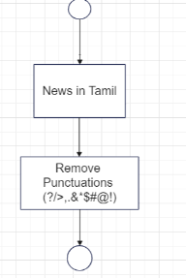
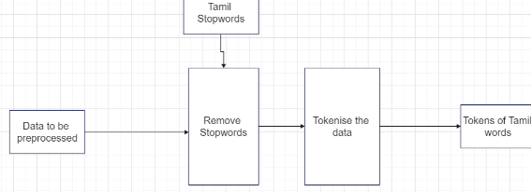
Architecture - Preprocessing
Removing Punctuation
Removing Stopwords

Slide 10
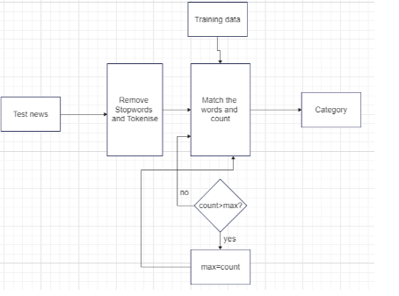
Method 1 - Bruteforce Approach

Slide 11
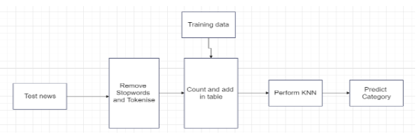
Method 2 - KNN

Slide 12
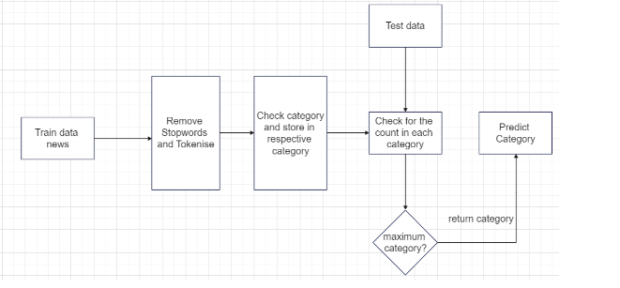
Method 3 - Word Classification

Slide 13
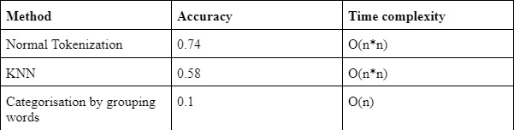
Results and Discussions
The methods were checked with the test data. The performance metric used for this purpose is accuracy. The results are tabulated in the below table:
As the results show us, more than KNN, or grouping, normal tokenization works better for Tamil News Categorisation. The future scope of this project can be extended towards developing models for categorisation of news in other regional languages as well as develop models with less time and space complexity.

Slide 14
Conclusion
From the table, we infer that normal tokenization with pre -trained embeddings for tamil language gives better results compared to KNN and grouping trained with count words feature vectors. The reason for this may be due to the occurrence of new tokens in politics test data than in cinema and sports. In future, we can accommodate the same methodology for other social media data as done for news web data. Also, sentiment of the data can be analysed after topic categorization. This will help in further improving the standard of the project.

Slide 15
THANK YOU!!

